Slide 1









TEAM NAME: ILC COLLEGE NAME : Panimalar Engineering College PROBLEM STATEMENT: Industries emit large amounts of carbon dioxide every year, contributing to climate change.Although companies plant trees to offset emissions, there is no reliable system to track whether the planted trees actually absorb enough carbon to balance the emissions.

Slide 2

PROBLEM STATEMENT
Forum Of Data Science Engineers
Industries release large amounts of carbon dioxide into the atmosphere, which contributes significantly to climate change. Although many companies plant trees to offset these emissions, there is currently no reliable system to verify whether the planted trees actually absorb enough carbon to balance the emissions. This lack of monitoring makes it difficult to ensure true carbon neutrality and environmental accountability.

Slide 3
SOLUTION
Forum Of Data Science Engineers
• Develop a system to track and analyze carbon emissions generated by industries.
• Calculate the number of trees required to offset the emitted carbon based on environmental models.
• Use satellite imagery to monitor the growth and health of planted trees on a weekly basis.
• Apply AI-based models to estimate the amount of carbon absorbed by the trees over time.
• Continuously compare industrial carbon emissions with the carbon absorbed by the planted trees.
• Provide a dashboard that shows industries their real-time carbon balance and sustainability status.

Slide 4
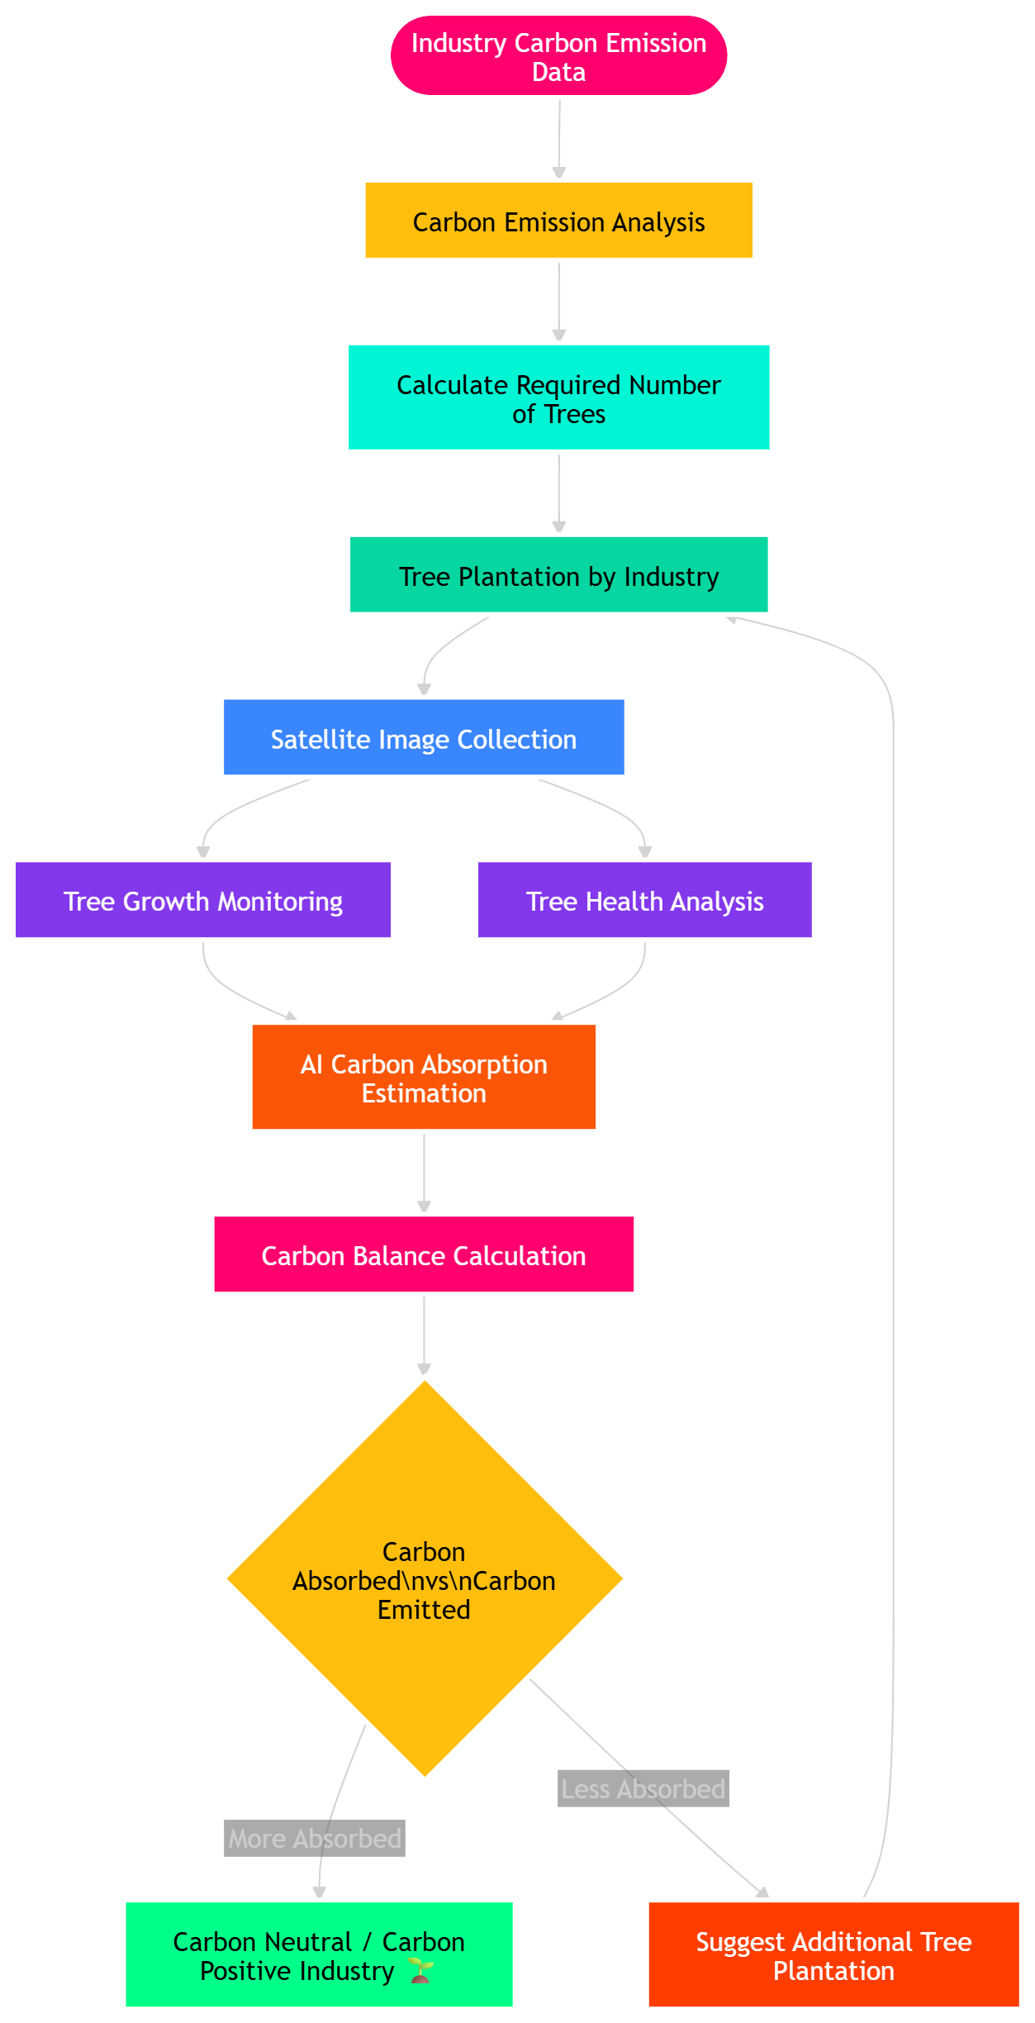
FLOW DIAGRAM
Forum Of Data Science Engineers

Slide 5
TECHNICAL REQUIREMENTS
Forum Of Data Science Engineers
• Satellite imagery data for monitoring tree plantations.
• AI / Machine Learning models to estimate tree growth and carbon absorption.
• Carbon emission calculation models for industrial data.
• Image processing techniques for analyzing satellite images.
• Cloud database to store environmental and monitoring data.
• Web dashboard for industries to track carbon balance and sustainability status.
• GIS (Geographic Information System) tools for location-based monitoring.

Slide 6
NOVELTY / USE CASE
Forum Of Data Science Engineers
This project introduces a smart system that helps industries achieve carbon neutrality by combining tree plantation tracking with satellite monitoring and AI-based carbon absorption estimation. Unlike traditional carbon offset programs that rely on manual reporting, this solution provides a transparent and data-driven method to verify whether planted trees are actually absorbing enough carbon to balance industrial emissions. By continuously monitoring tree growth and comparing carbon absorbed with carbon emitted, the system ensures accountability, prevents greenwashing, and supports industries in maintaining a measurable and sustainable environmental impact.

Slide 7
BUSINESS MODEL / TARGET MARKET
Forum Of Data Science Engineers
Business Model:
The platform can operate as a subscription-based service for industries that want to track and manage their carbon footprint. Companies can pay for access to the monitoring dashboard, carbon analysis reports, and satellite-based verification of their plantation projects. Additional revenue can be generated through carbon certification reports, sustainability analytics, and partnerships with environmental agencies or government carbon credit programs. Target Market:
The primary target market includes manufacturing industries, power plants, large corporations, and industrial parks that produce significant carbon emissions and aim to achieve sustainability goals. It can also serve government environmental bodies, carbon credit organizations, and sustainability-focused companies that require reliable monitoring of carbon offset initiatives and environmental impact.
D E S I G N . D E V E L O P . D E P L O Y

Slide 8
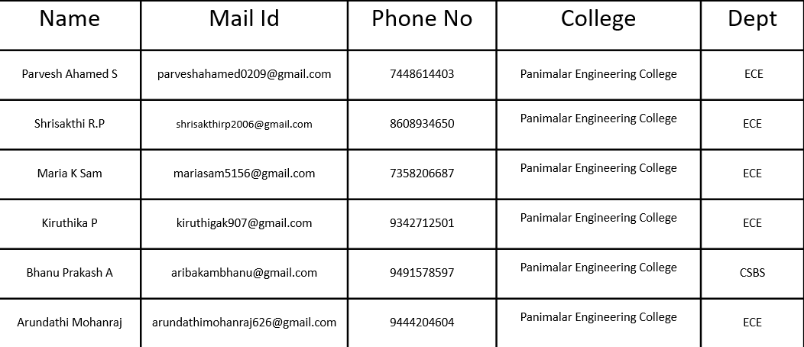
TEAM DETAILS
Forum Of Data Science Engineers
ROLE
NAME
STREAM/DEPT
YEAR
COLLEGE

